Slide 1
Comparative Analysis of Deep Learning Models for Fire Prediction

Slide 2
Study Overview
Study Area: The study focuses on fire data specific to Thailand and Malaysia, regions prone to seasonal and large-scale fire incidents.
Dataset Period: The dataset includes 150 monthly fire data points spanning from January 2012 to June 2024.
Outcome: Evaluate the predictive effectiveness of three deep learning models-GRU, Transformer, and LSTM, for fire incident forecasting.

Slide 3
Deep Learning Algorithms
LSTM (Long Short-Term Memory):
A type of recurrent neural network (RNN) designed to capture long-term dependencies in sequential data by addressing the vanishing gradient problem. It uses memory cells and gates to retain important information over time, making it suitable for time-series forecasting.
GRU (Gated Recurrent Unit):
A simpler variant of LSTM with fewer parameters. It combines the forget and input gates into a single update gate, making it computationally efficient while still effectively learning dependencies in sequential data.
Transformer:
A deep learning model that uses self-attention mechanisms to capture global dependencies in the data. Unlike LSTM and GRU, it processes entire sequences at once, enabling parallel computation and improving performance on long-range sequential tasks.

Slide 4
Thailand

Slide 6
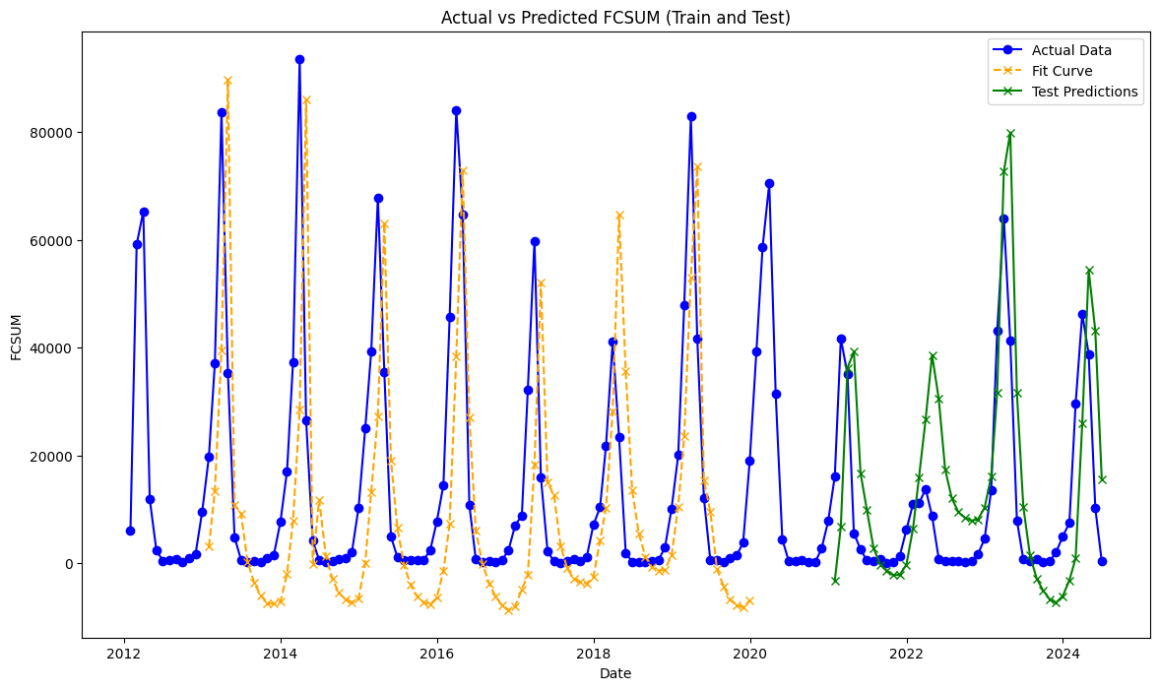
Long Short-Term Memory

Slide 7
LSTM - Statistical Metrics
MSE | 139623899.79
RMSE | 11816.25
MAE | 8183.66
R² | 0.47

Slide 8
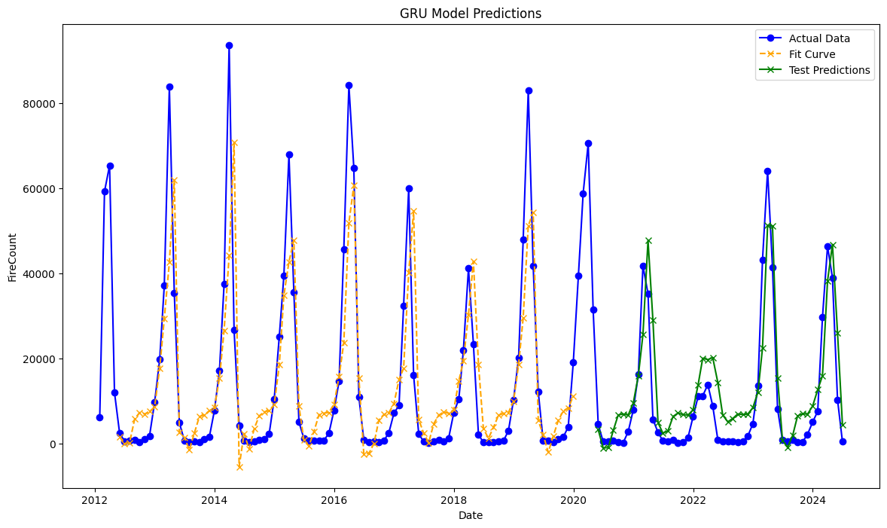
Gated Recurrent Unit

Slide 9
GRU - Statistical Metrics
MSE | 67029380.13
RMSE | 8187.14
MAE | 6409.31
R² | 0.71

Slide 10
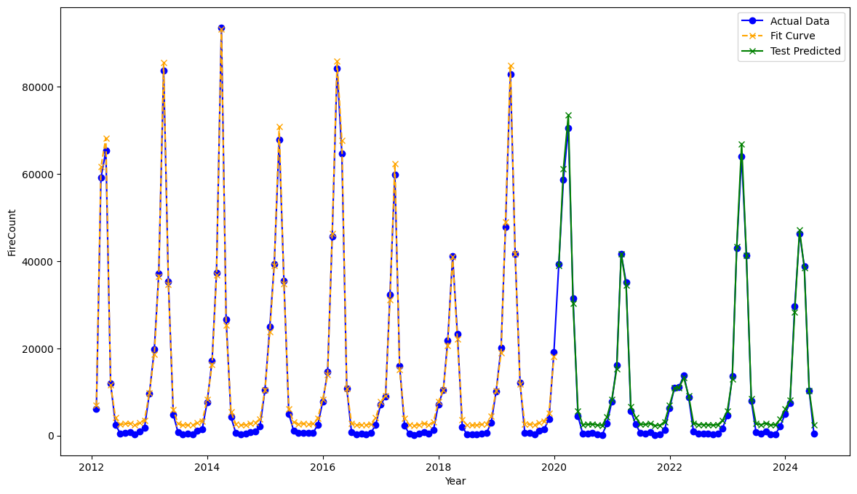
Transformer

Slide 11
Transformer - Statistical Metrics
MSE | 2752006.0
RMSE | 1658.91
MAE | 1334.24
R² | 0.99

Slide 12
 | LSTM Model | GRU Model | Transformer Model
Mean Squared Error | 139623899.79 | 67029380.13 | 2752006.0
Root Mean Squared Error | 11816.25 | 8187.14 | 1658.91
Mean Absolute Error | 8183.66 | 6409.31 | 1334.24
R² Test | 0.47 | 0.71 | 0.99
Out of all three models, based on the metrics, Transformer Model appears to be the most preferable choice.

Slide 13
Malaysia

Slide 14
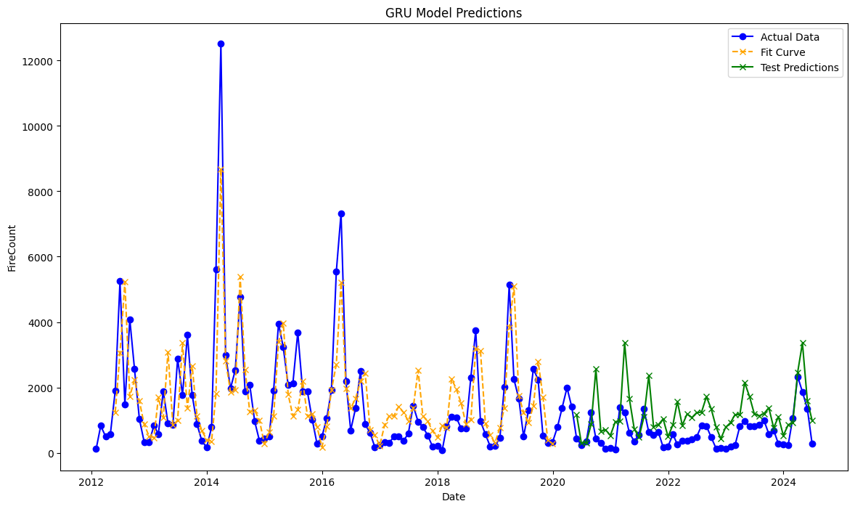
Gated Recurrent Unit

Slide 15
GRU - Statistical Metrics
MSE | 630695.83
RMSE | 794.16
MAE | 631.16
R² | 0.36

Slide 16
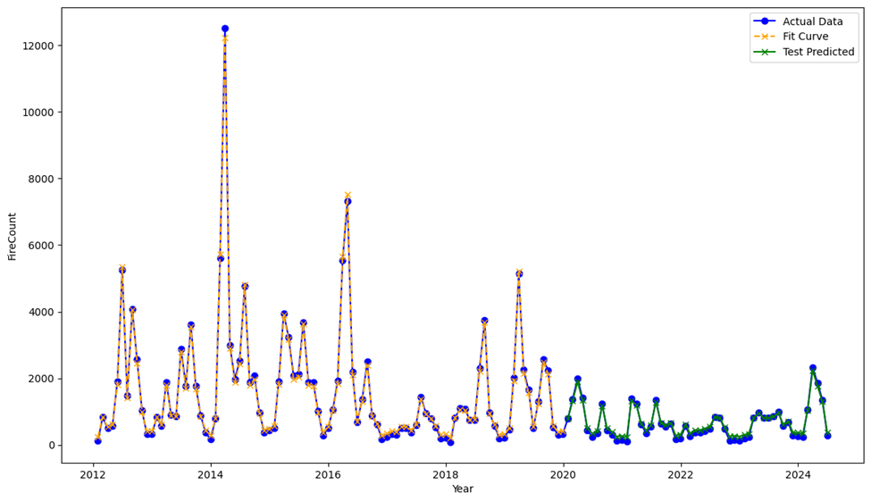
Transformer

Slide 17
Transformer - Statistical Metrics
MSE | 21045.21
RMSE | 145.07
MAE | 142.16
R² | 0.92

Slide 18
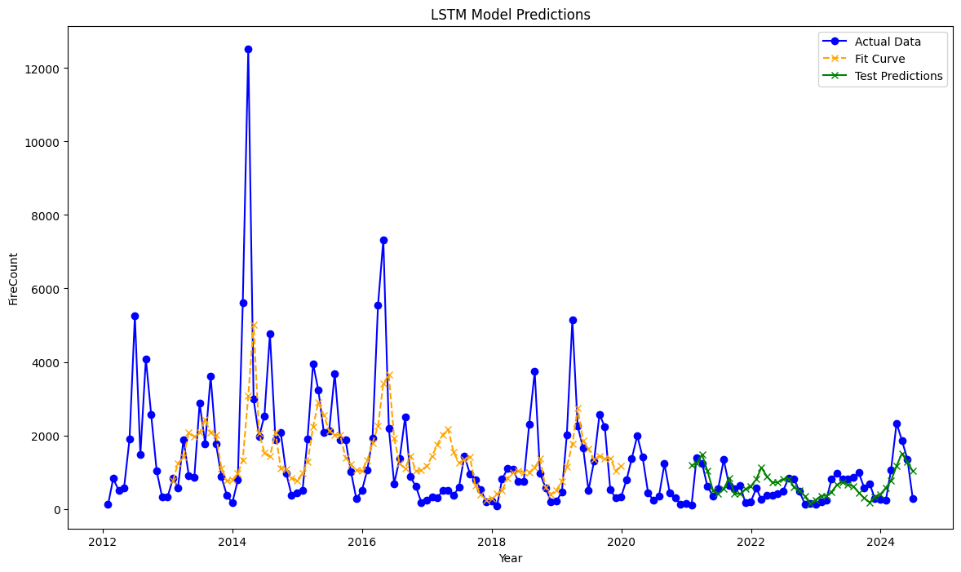
Long Short-Term Memory

Slide 19
LSTM - Statistical Metrics
MSE | 173273.39
RMSE | 416.26
MAE | 416.26
R² | 0.25

Slide 20
 | LSTM Model | GRU Model | Transformer Model
Mean Squared Error | 173273.39 | 630695.83 | 21045.21
Root Mean Squared Error | 416.26 | 794.16 | 145.07
Mean Absolute Error | 320.14 | 631.16 | 142.16
R² Test | 0.25 | 0.36 | 0.92
Out of all three models, based on the metrics, Transformer Model appears to be the most preferable choice.

Slide 21
 | THAILAND |  |  | MALAYSIA
 | LSTM Model | GRU Model | Transformer Model | LSTM Model | GRU Model | Transformer Model
Mean Squared Error | 139623899.79 | 67029380.13 | 2752006.0 | 173273.39 | 630695.83 | 21045.21
Root Mean Squared Error | 11816.25 | 8187.14 | 1658.91 | 416.26 | 794.16 | 145.07
Mean Absolute Error | 8183.66 | 6409.31 | 1334.24 | 320.14 | 631.16 | 142.16
R² Test | 0.47 | 0.71 | 0.99 | 0.25 | 0.36 | 0.92

Slide 22
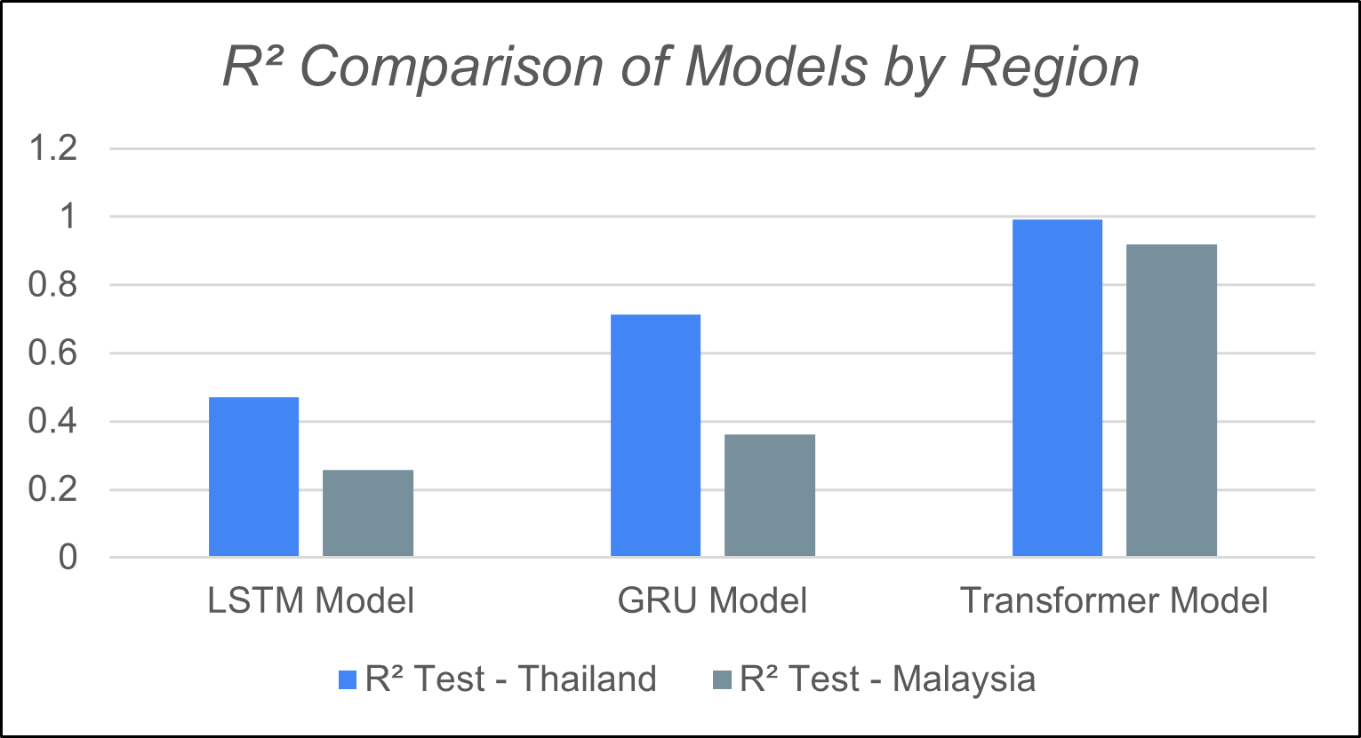
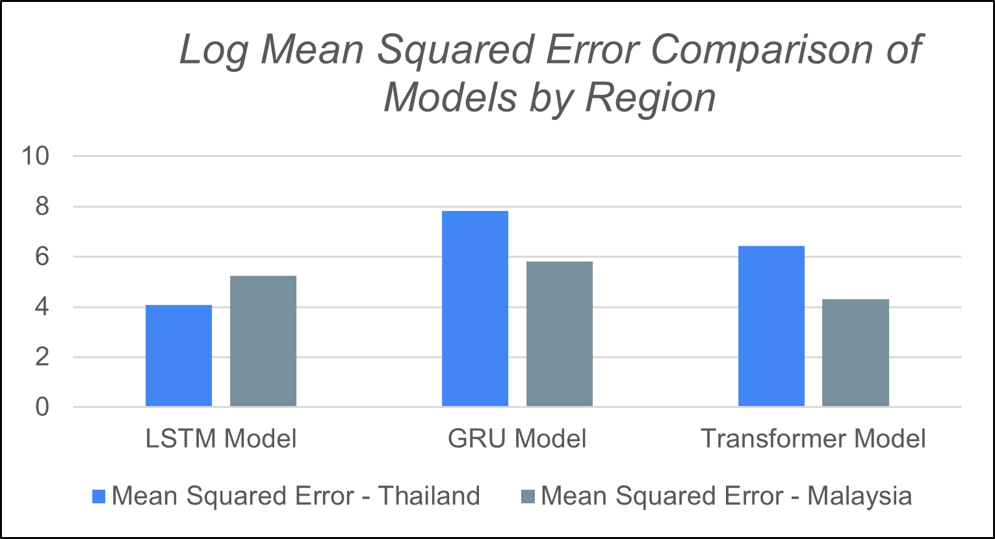
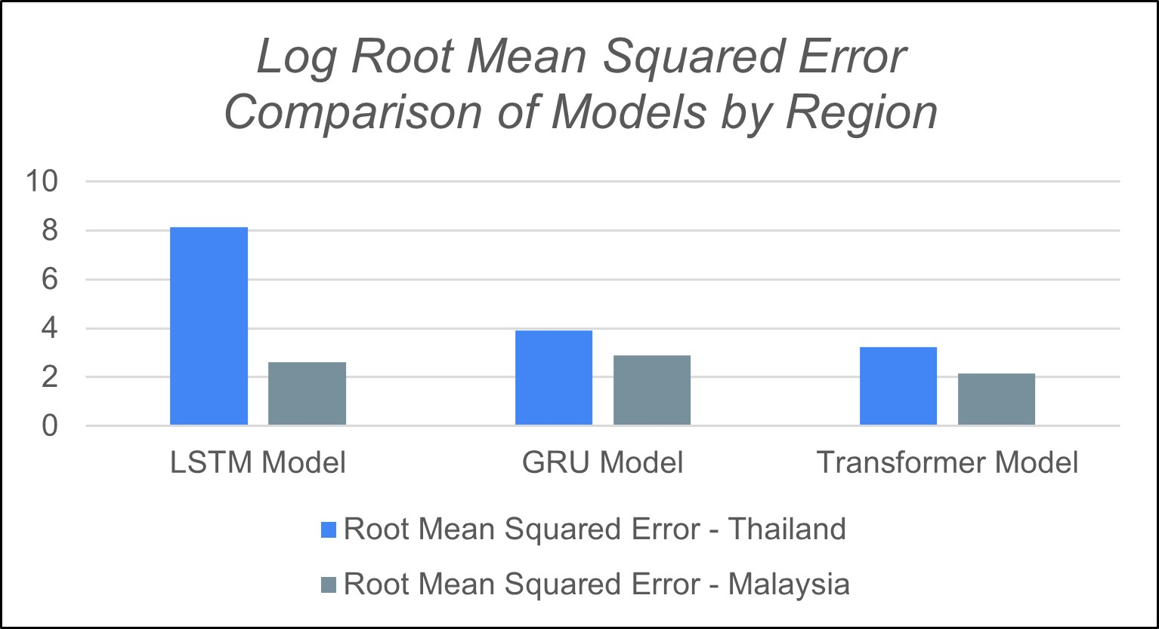
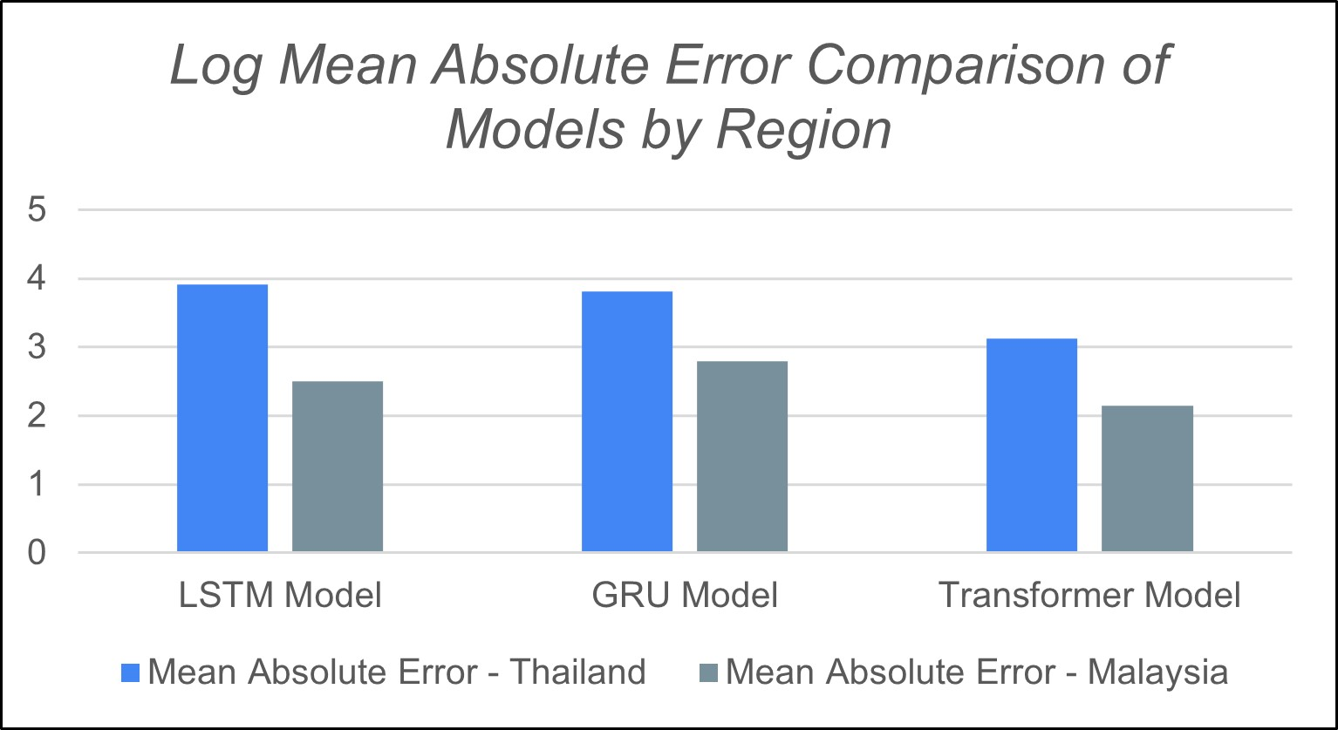

Slide 23
Results
LSTM Model
Showed poor predictive accuracy, especially in Malaysia, with a low R² score of 0.257 and high error metrics.
Performed slightly better in Thailand (R²: 0.470) but still struggled to capture trends effectively.
GRU Model
Delivered moderate performance, with an R² score of 0.713 in Thailand, outperforming LSTM in this region.
Struggled in Malaysia (R²: 0.361) and had higher error metrics compared to the Transformer model.
Transformer Model
Achieved the lowest errors and the highest R² scores in both Thailand (0.992) and Malaysia (0.919), indicating excellent predictive accuracy.
Consistently outperformed both LSTM and GRU models, effectively capturing trends and data variance.

